Slide 1
Word Meaning and Similarity
Word Similarity: Thesaurus Methods

Slide 2
Word Similarity
Synonymy: a binary relation
Two words are either synonymous or not
Similarity (or distance): a looser metric
Two words are more similar if they share more features of meaning
Similarity is properly a relation between senses
The word “bank” is not similar to the word “slope”
Bank¹ is similar to fund³
Bank² is similar to slope⁵
But we’ll compute similarity over both words and senses

Slide 3
Why word similarity
Information retrieval
Question answering
Machine translation
Natural language generation
Language modeling
Automatic essay grading
Plagiarism detection
Document clustering

Slide 4
Word similarity and word relatedness
We often distinguish word similarity from word relatedness
Similar words: near-synonyms
Related words: can be related any way
car, bicycle: similar
car, gasoline: related, not similar

Slide 5
Two classes of similarity algorithms
Thesaurus-based algorithms
Are words “nearby” in hypernym hierarchy?
Do words have similar glosses (definitions)?
Distributional algorithms
Do words have similar distributional contexts?

Slide 6
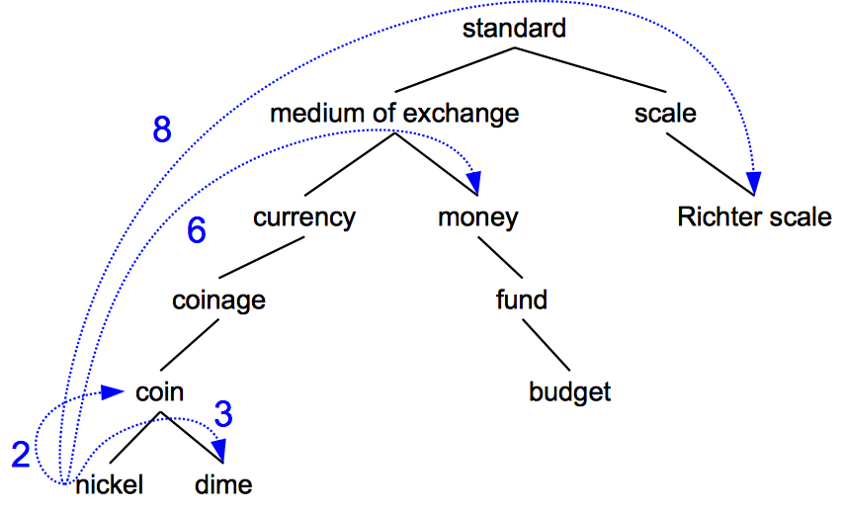
Path based similarity
Two concepts (senses/synsets) are similar if they are near each other in the thesaurus hierarchy
=have a short path between them
concepts have path 1 to themselves

Slide 7
Refinements to path-based similarity
pathlen(c₁,c₂) = 1 + number of edges in the shortest path in the hypernym graph between sense nodes c₁ and c₂
ranges from 0 to 1 (identity)
simpath(c₁,c₂) =
wordsim(w₁,w₂) = max sim(c₁,c₂)
c₁∈senses(w₁),c₂∈senses(w₂)

Slide 8
Example: path-based similarity simpath(c₁,c₂) = 1/pathlen(c₁,c₂)
simpath(nickel,coin) = 1/2 = .5
simpath(fund,budget) = 1/2 = .5
simpath(nickel,currency) = 1/4 = .25
simpath(nickel,money) = 1/6 = .17
simpath(coinage,Richter scale) = 1/6 = .17

Slide 9
Problem with basic path-based similarity
Assumes each link represents a uniform distance
But nickel to money seems to us to be closer than nickel to standard
Nodes high in the hierarchy are very abstract
We instead want a metric that
Represents the cost of each edge independently
Words connected only through abstract nodes
are less similar

Slide 10
Information content similarity metrics
Resnik 1995. Using information content to evaluate semantic similarity in a taxonomy. IJCAI
Let’s define P(c) as:
The probability that a randomly selected word in a corpus is an instance of concept c
Formally: there is a distinct random variable, ranging over words, associated with each concept in the hierarchy
for a given concept, each observed noun is either
a member of that concept with probability P(c)
not a member of that concept with probability 1-P(c)
All words are members of the root node (Entity)
P(root)=1
The lower a node in hierarchy, the lower its probability

Slide 11
Information content similarity
entity
…
geological-formation
Train by counting in a corpus
Each instance of hill counts toward frequency
of natural elevation, geological formation, entity, etc
Let words(c) be the set of all words that are children of node c
words(“geo-formation”) = {hill,ridge,grotto,coast,cave,shore,natural elevation}
words(“natural elevation”) = {hill, ridge}
natural elevation
cave
shore
hill
ridge
grotto
coast

Slide 12
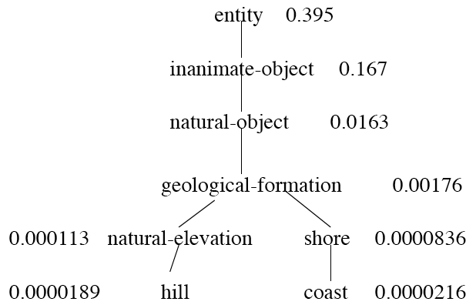
Information content similarity
WordNet hierarchy augmented with probabilities P(c)
D. Lin. 1998. An Information-Theoretic Definition of Similarity. ICML 1998

Slide 13
Information content: definitions
Information content:
IC(c)= -log P(c)
Lowest common subsumer
LCS(c₁,c₂)=
The lowest node in the hierarchy that subsumes both c₁ and c₂
How to use information content IC as a similarity metric?

Slide 14
Resnik method
The similarity between two words is related to their common information
The more two words have in common, the more similar they are
Resnik: measure common information as:
The information content of the lowest
common subsumer of the two nodes
sim_{resnik}(c₁,c₂) = -log P( LCS(c₁,c₂) )

Slide 15
Dekang Lin method
Dekang Lin. 1998. An Information-Theoretic Definition of Similarity. ICML
Intuition: Similarity between A and B is not just what they have in common
The more differences between A and B, the less similar they are:
Commonality: the more A and B have in common, the more similar they are
Difference: the more differences between A and B, the less similar
Commonality: IC(common(A,B))
Difference: IC(description(A,B)-IC(common(A,B))

Slide 16
Dekang Lin similarity theorem
The similarity between A and B is measured by the ratio between the amount of information needed to state the commonality of A and B and the information needed to fully describe what A and B are
Lin (altering Resnik) defines IC(common(A,B)) as 2 x information of the LCS

Slide 17
Lin similarity function

Slide 18
The (extended) Lesk Algorithm
A thesaurus-based measure that looks at glosses
Two concepts are similar if their glosses contain similar words
Drawing paper: paper that is specially prepared for use in drafting
Decal: the art of transferring designs from specially prepared paper to a wood or glass or metal surface
For each n-word phrase that’s in both glosses
Add a score of n²
Paper and specially prepared for 1 + 2² = 5
Compute overlap also for other relations
glosses of hypernyms and hyponyms

Slide 19
Summary: thesaurus-based similarity

Slide 20
Libraries for computing thesaurus-based similarity
NLTK
http://nltk.github.com/api/nltk.corpus.reader.html?highlight=similarity - nltk.corpus.reader.WordNetCorpusReader.res_similarity
WordNet::Similarity
http://wn-similarity.sourceforge.net/
Web-based interface:
http://marimba.d.umn.edu/cgi-bin/similarity/similarity.cgi

Slide 21
Evaluating similarity
Intrinsic Evaluation:
Correlation between algorithm and human word similarity ratings
Extrinsic (task-based, end-to-end) Evaluation:
Malapropism (spelling error) detection
WSD
Essay grading
Taking TOEFL multiple-choice vocabulary tests
Levied is closest in meaning to:
imposed, believed, requested, correlated

Slide 22
Word Meaning and Similarity
Word Similarity: Thesaurus Methods

